Slide 1
Computational Geometry (35)
Line Segments and cross-product
Segment intersection and Sweep Line
Convex Hull and Graham’s Scan, Jarvis’s march
Divide-and-Conquer for Closest Pair.

Slide 2
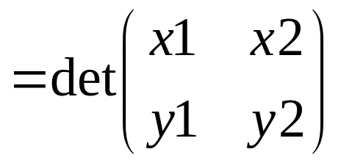
Line Segments and cross-product (35.1)
A segment is a convex combination of ends
  p1 = (x1,y1) and p2 = (x2,y2)
  x = α x1+ (1-α) x2, y = α y1+ (1-α) y2
  p = α p1+ (1-α) p2
Cross product
  p1 × p2 = x1 y2 -x2 y1
  Vectors are collinear if p1 = c p2, cross-product=0
  The segment [p0p1] and [p0p2] turns left or right if
  (p1-p0) × (p2-p0) > 0 (<0)
  Segment intersection:
    bounding boxes
    straddling

Slide 3
Segments and Sweep Line (35.2)
Sweep line is an imaginary vertical line moving from left to right
a1 is above a2 and a3 is above a2
a1
a3
a2

Slide 4
Convex Hull(35.3)
Convex Hull, CH(X), is the smallest convex polygon containing all points from X, |X|=n
Different methods:
  incremental: moving from left to right updates CH(x1..xi). the runtime O(nlogn)
  divide-and-conquer divides into two subsets left and right in O(n), then combine into one convex hull in O(n)
  prune-and-search O(n logh), where h is the # points in CH uses pruning as for finding median to find upper chain

Slide 5
Graham’s Scan (35.3)
O(nlogn)

Slide 6
Finding the Closest Pair(35.4)
Brute-force: O(n²)
Divide-and-conquer algorithm with recurrence
T(n)=2T(n/2)+O(n)
Divide: divide into almost equal parts by a vertical line which divides given x-sorted array X into 2 sorted subarrays
Conquer: Recursively find the closest pair in each half of X. Let δ = min{δ_{left}, δ_{right}}
Combine: The closest pair is either in distance δ or a pair of points from different halves.

Slide 7
Combine in D-a-C (35.4)
Subarray Y’ (y-sorted) of Y with points in 2δ strip
∀p∈Y’ find all in Y’ which are closer than in δ
  no more than 8 in δ × 2δ rectangle
  no more than 7 points can be closer than in δ
If the closest in the strip closer then it is the answer
2δ
2δ
δ
δ
left
right

Slide 8
Voronoi Graph
Voronoi region Vor(p) (p in set S)
  the set of points on the plane that are closer to p than to any othe rpoint in S
Voronoi Graph VOR(S)
  dual to voronoi region graph
  two points are adjacent if their voronoi regions have common contiguous boundary (segment)

Slide 9
Voronoi Graph
Voronoi Graph in the rectilinear plane
Rectilinear distance: p = (x, y); p’=(x’,y’)
ab
Voronoi region of b
b
a
bc
c
ac

